Slide 1

Experimental investigation of the effect of silica fume on geopolymer mortar cured under ambient temperature
23rd Conference "Rheology of Building Materials", University of Technology Regensburg, Germany, March, 12-13, 2014
Mohammed Al-Majidi Supervisors: Dr Andreas Lampropoulos
Prof. Andrew Cundy
Dr. Pierfrancesco Cacciola

Slide 2
Content
Challenge & Opportunities in the world concrete
Why Geopolymer concrete & knowledge Gap
Geopolymer concrete Applications
Aim and Objectives
Methodology
Results
Conclusion

Slide 3
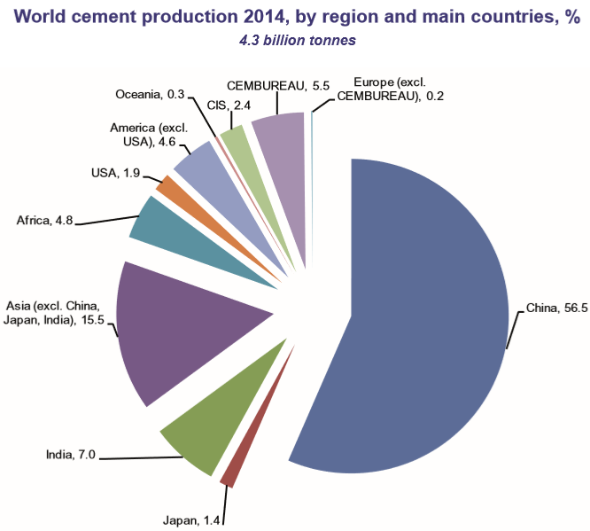
Challenge & Opportunities in the world concrete
Challenge
Demand and Facts:
  Ranking of mankind’s use :
  1. Water
  2. OPC (+ Fly Ash, Slag, …)concrete
  In 2014, global cement
  Production was 4.3 billion tonnes

Slide 4
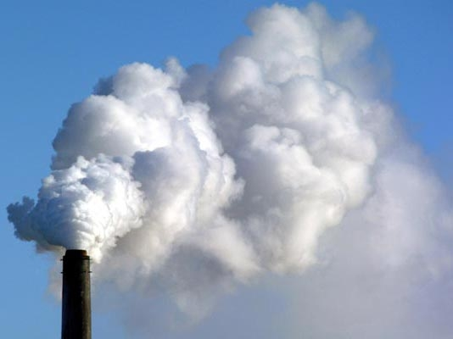
Challenge & Opportunities in the world concrete
Challenge
  OPC consumes considerable amount of virgin materials resources and energy about 5% of worldwide industrial energy consumption.
OPC contributes 5-8% of global CO2 emissions
1 tonne of OPC 0.8 – 1 tonne of CO2
This is creating a challenging situation in the world of concrete

Slide 5
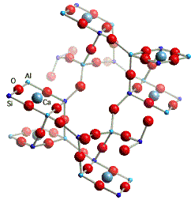
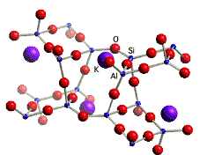
Challenge & Opportunities in the world concrete
Opportunities
The term geopolymer was firstly investigated by the French researcher Davidovits in 1978.
Geopolymers are inorganic materials rich in silicon (Si) and Aluminium (Al) that react with alkaline activators to become cementitious material.

Slide 6

Why Geopolymer Concrete& Knowledge Gaps
Wide range of application.
80% less CO2 generation than OPC.
Utilization of by-product material
Low energy consumption
Better durability & longevity
Conserve hundred of thousands of acres currently used for disposal of coal consumption products.
Qualifies as Green

Slide 7
Why Geopolymer Concrete & knowledge Gaps
Some engineering properties of geopolymer concrete GC compared to OPC:
Properties | Comments
Workability | High value of Slump Test
Density | 2000-2300 Kg/m3
Compressive Strength | 90MPa has been reported with heat curing
Durability | -Sulphate resistance: excellent -Sulphuric acid resistance: high resistance compared to OPC - Temperature resistance: stable at 800°C

Slide 8
Why Geopolymer Concrete & Knowledge Gaps
Properties | Comments
Curing | Need high temperature Curing between 40 and 80 °C for at least 6hrs for hardening the GC. The long heat curing period arguably limits the structural application of the geopolymer. Therefore, the realization of the room temperature curing of geopolymers is critical for various commercial uses

Slide 9
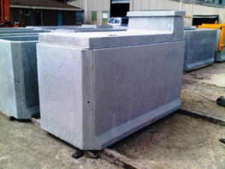
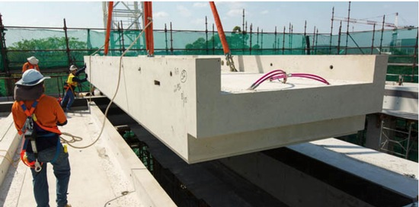
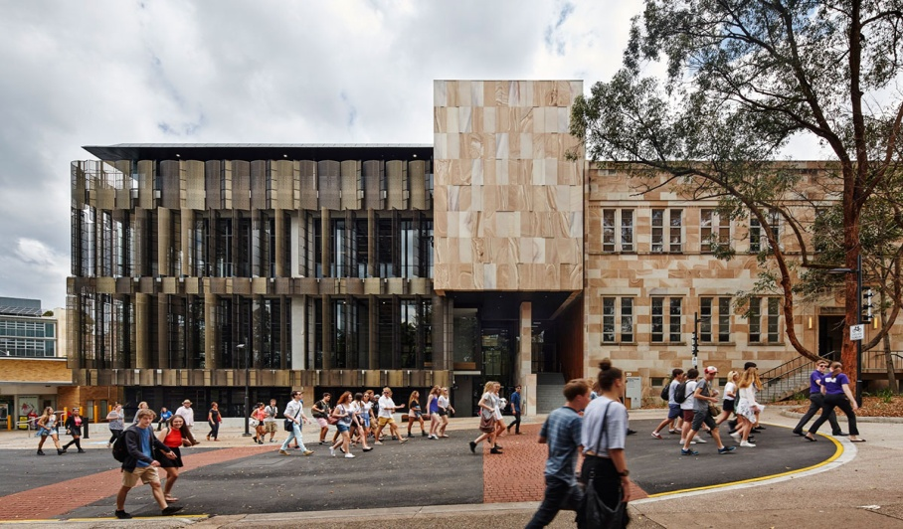
Geopolymer concrete Applications
Some current GC products:
UQ’s Global Change Institute (GCI) building
First to use cement-free concrete for structural
Purposes
2500 tonnes of precast geopolymer

Slide 10
Aims and Objective
Aims;
The present study aims to develop the performance of geopolymer cured under ambient temperature by using ternary geopolymer mixture (fly ash, slag and silica fume) with potassium silicate as alkaline activator.
Objectives;
1- Study and Optimise the mix design (Sustainable material) of fly ash based geopolymer concrete cured in ambient temperature.
2- To examine the influence of slag content and particle size distribution of Silica fume on the fresh and hardened properties of geopolymer mortar

Slide 11

Methodology

Slide 12
Methodology
Materials
Fly ash (By product from coal consumption)
Ground Granulated Blast Slag (GGBS), or slag (by product from smelting of the siliceous gangue found in iron ore.
Silica Fume (Densified, Undensified and Slurry) (by product material of the smelting process in the silicon and ferrosilicon industry)
Alkaline activator potassium hydroxide (KOH) and potassium silicate (K2SiO3)
Fine silica sand
Admixture: Superplasticizer Sika Viscoflow 2000
Silica fume form | Bulk density (kg/m³) | Particle Size (µm)
Densified silica (DSF) | 130-430 | 204
Undensified silica (USF) | 1320-1440 | 37
Slurry silica (SSF) | 480-720 | 0.3

Slide 13
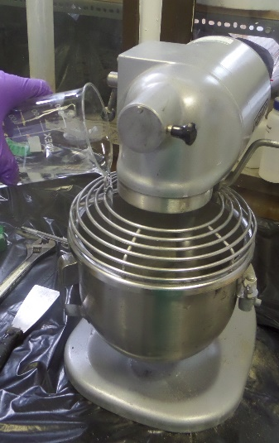
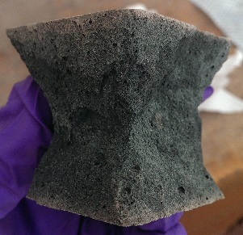

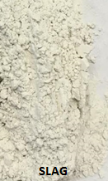
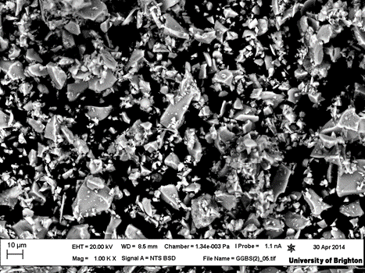
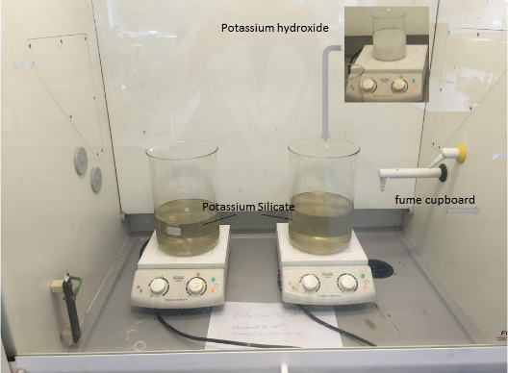
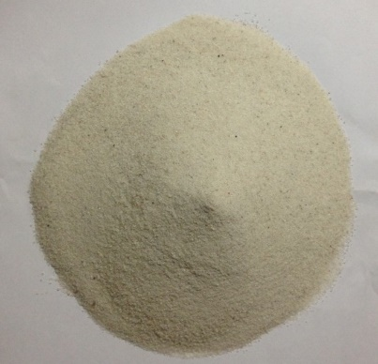
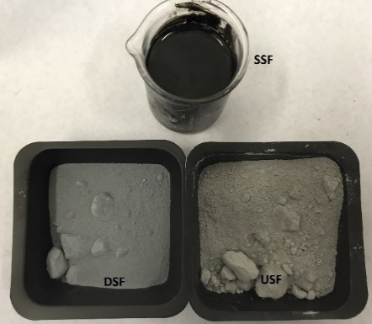
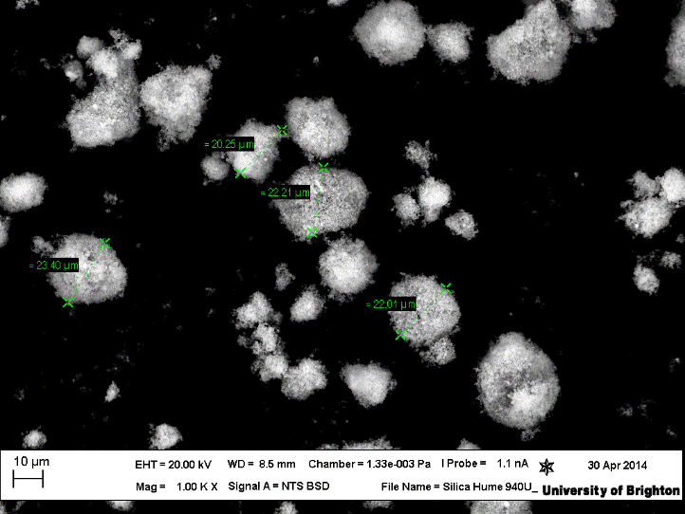
Methodology
Manufacture geopolymer mortar
First; Mixing the solid binder together
Geopolymer mortar
Mixing the solid binder with alkaline activator
by Hobart Mixer
Prepare Potassium silicate MR 1.25 in
advance 24hrs before mixing with binder
Silica Sand

Slide 14
Methodology
Experimental work:
Preliminary study
Select proper mixing steps and mixing time
Select water content in Geopolymer concrete
The Optimum Binder composition Under Ambient Temperature
The optimum Slag/ Fly Ash binder ratio
Select Silica fume form and content.
The proper admixture percentage (Superplasticizer )
The effective chemical activator content

Slide 15
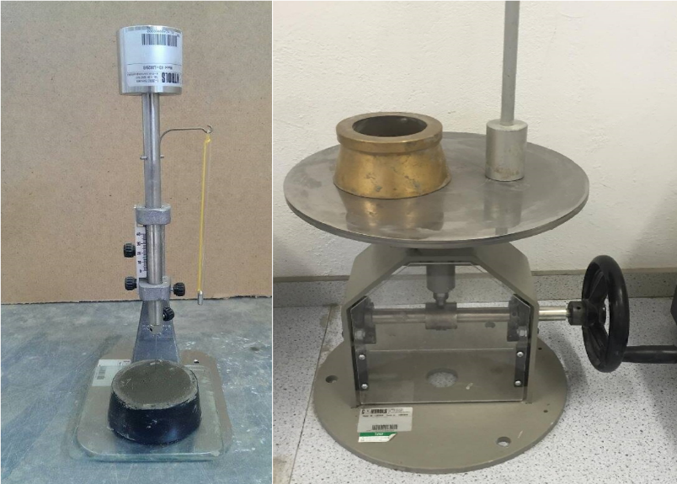
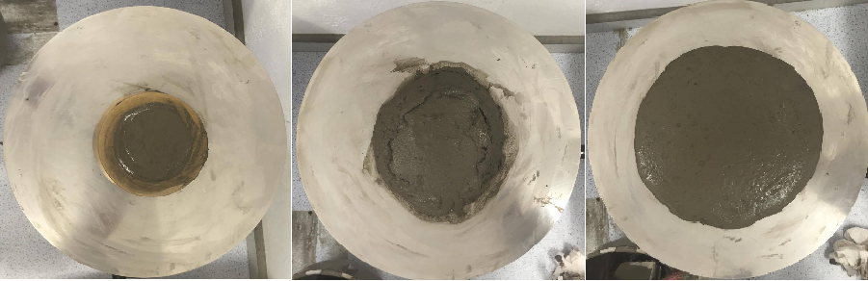
Methodology
List of test in the Research
Flowtable test
Setting time test
Compressive strength test
Scanning electronic microscopy (SEM)
Setting time apparatus Flowability apparatus
Before removal
Flow mould
After removal of the flow mould
After 25 drops

Slide 16


Slide 17
Results
Based on the initial experimental work done in the University of Brighton laboratory.
Mixing steps (as described in the previous slide)
The optimum mix proportion in term of workability and strength;
Water to binder ratio=0.25
Potassium silicate to binder=0.12
Superplasticizer to binder=0.01

Slide 18
Results
Effect of Slag content and silica fume forms on the workability of geopolymer plain

Slide 19
Results
Effect of Slag content and Silica fume forms on the setting time of geopolymer mortar

Slide 20
Results
Effect of Slag content and Silica fume forms on the compressive strength of geopolymer mortar

Slide 21
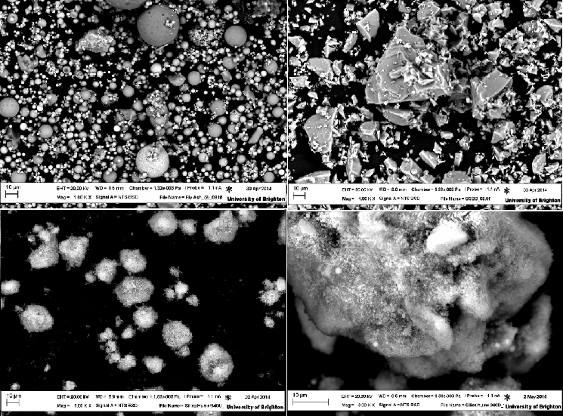
Scanning Electronic Microscopy (SEM)
SEM images showing the characteristic morphology of the original fly ash, USF particles consist of spherical primary particles; agglomerates of silica fume particles are formed in DSF while the angular particles of slag
Fly Ash
Slag
USF
DSF

Slide 22
Scanning Electronic Microscopy (SEM)
Control mix
10% DSF mortar
10%USF mortar
5%SSF mortar

Slide 23
Conclusion
Increasing the slag content in the examined mixes decreases the workability and accelerates the setting times (initial and final).
The inclusion of silica fume in the geopolymer mortar has various effects on the flow of fly ash and slag based geopolymer mortar depending on the particle size distribution

Slide 24
conclusion
Compressive strength of geopolymer mortar was increased as the slag content was increased and with the age of the specimens.
The replacement of silica fume with average particle size in between (0.2-37µm) by 10% undensified silica fume and 5% slurry silica provided higher compressive strength than the control slag/fly ash mortar.
Geopolymer mortar can be manufacturer cured under ambient temperature

Slide 25
Thanks for listening
&
Questions

